Slide 1

Department of Computer Science and Engineering
A Comprehensive Health Score Dietetics Platform
Batch Members: | Under the Guidance of
LAKSHNA K (730320104011) | Dr. P. THANGARAJ,
SHOBANA M (730320104021) | PROFESSOR,DIRECTOR/KGI
VARSHINI S (730320104024)

Slide 2
Abstract
An innovative web-based solution designed to empower users in managing their health effectively. Through this platform, users can register and login to access a suite of features aimed at promoting holistic well-being.
Key functionalities include the calculation of various health metrics such as BMI, heart rate, blood pressure, and more.
Additionally, the platform facilitates seamless appointment scheduling with healthcare practitioners, providing users with the opportunity to connect with specialists based on their unique needs and preferences.

Slide 3
Introduction
"Health Score Dietetics" offers a user-friendly online platform for comprehensive health management. Users can register and login to access tools for tracking vital health metrics like BMI and heart rate.
The system simplifies appointment scheduling with acurated list of healthcare practitioners.
Healthcare professionals can efficiently manage appointment requests for seamless user interaction.
Administrators have access to detailed insights, ensuring effective oversight of system operations.

Slide 4
Literature Survey
Title of The paper | Methodology | Publication details
Diagnosing Medical Score Calculator Apps | Based on supplied parameters, as well as the underlying score reference table. | Raina Samuel September 2023
Design of Health Detection System for Smart Watch | Based on the bio signal acquisition method. | Zhu Zhu 30 July 2022
The Nutri-Score nutrition label | It is based on a five – color scale (from dark green to dark orange) associated with letters, from A to E. | Hercberg 2021

Slide 5
Problem Statement
In today's fast-paced world, individuals often struggle to effectively manage their health due to various challenges such as lack of access to reliable health information, difficulty in scheduling appointments with healthcare professionals.
By providing tools for calculating and tracking essential health metrics, as well as facilitating convenient appointment scheduling with qualified healthcare practitioners.

Slide 6
Block Diagram of proposed System
Registration
Admin
Store
User Details
Register
Store
Health Practitioner Details
Health Practitioner
Register
Calculation of activities
View
Update
Enter Values
US Result
User(Patient)
Fill Details
Request for appointment
Update
Metrics Result
View
Store
Allow/
Deny appointment request
Health Practitioner
Appointment Table
Allow/Deny
Request
Update

Slide 7
Existing System Vs Proposed System
Existing System:
In the existing system, users must navigate multiple websites to calculate metrics like BMI and heart rate, and to book appointments with healthcare providers.
This fragmented process frequently leads to dissatisfaction with information retrieval.
Proposed System:
Proposed solution eliminates the need for users to navigate multiple websites, ensuring a streamlined and satisfactory experience.
It features a secure login system, including an admin portal for overseeing registered users and facilitating appointments with healthcare professionals.

Slide 8
Hardware & Software Specification
Hardware Specification:
Processor : Intel
Ram : 8GB RAM
Hard Disk : 50 GB or higher
Software Specification:
Front End : HTML, CSS, JavaScript
Back End : Node , Express
Database : MySQL

Slide 9
Tools Used
Programming Languages:
JavaScript: Both Server and client-side interactivity in web applications.
Web Development Tools:
Node JS: Used as the server side runtime environment to run JavaScript code and interact with database.
Express JS: Serves as the backend framework, handling HTTP requests from clients, interacting with the MySQL database, and generating responses.
Database:
MySQL: Used to store data and manipulation.

Slide 10
Project Outcomes
User-Friendly Web Application
Administrative Management
Consolidation of Health Services
Integrated Appointment Booking
Transparency and Communication
Data Storage and Accessibility
Comprehensive Health Monitoring

Slide 11
References
[1] G. Sengul, M. Karakaya, S. Misra, O. O. Abayomi-Alli, and
R. Damasevicius, “Deep learning based fall detection using
smartwatches for healthcare applications,” Biomedical Signal
Processing and Control, vol. 71, article 103242, 2022
[2] C. Krittanawong, A. J. Rogers, K. W. Johnson et al., “Integration of novel monitoring devices with machine learning
technology for scalable cardiovascular management,” Nature
Reviews Cardiology, vol. 18, no. 2, pp. 75–91, 2021.
[3] G. Cicirelli, R. Marani, A. Petitti, A. Milella, and T. D’Orazio,
“Ambient assisted living:future perspectives for healthy aging of population,”Sensors, vol. 21, no. 10, p. 3549, 2021.

Slide 12
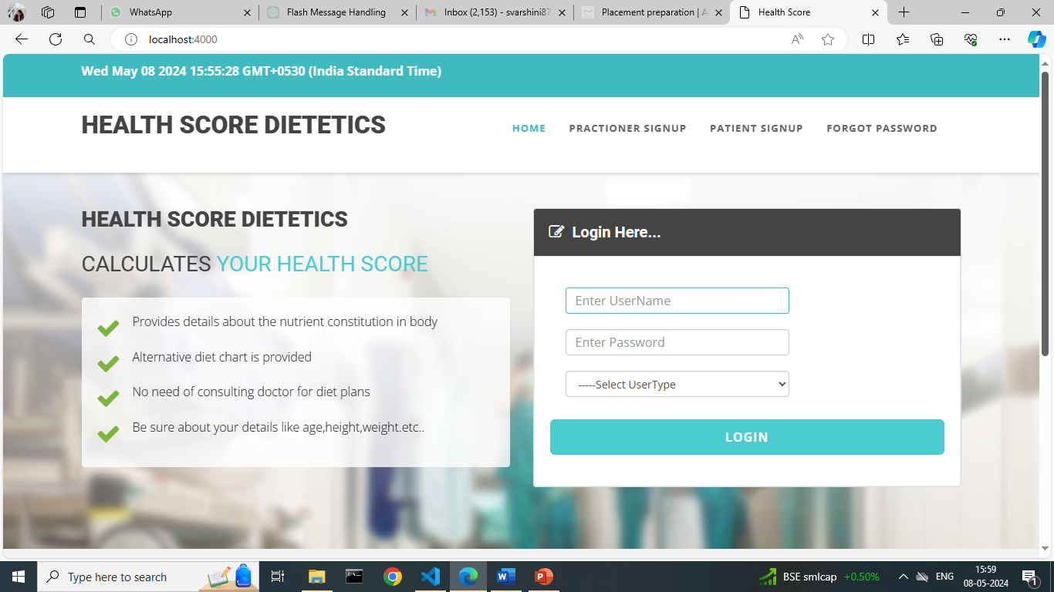
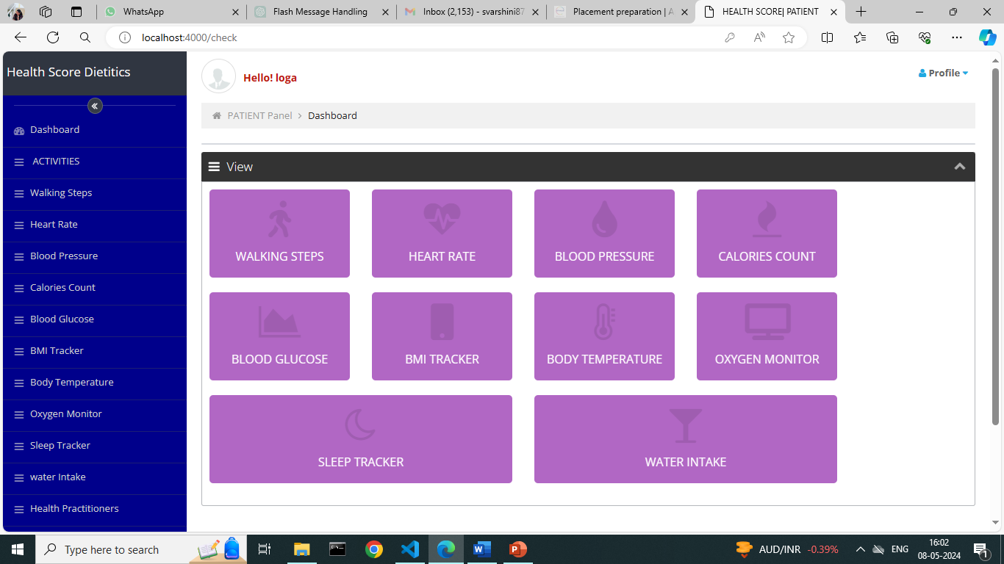
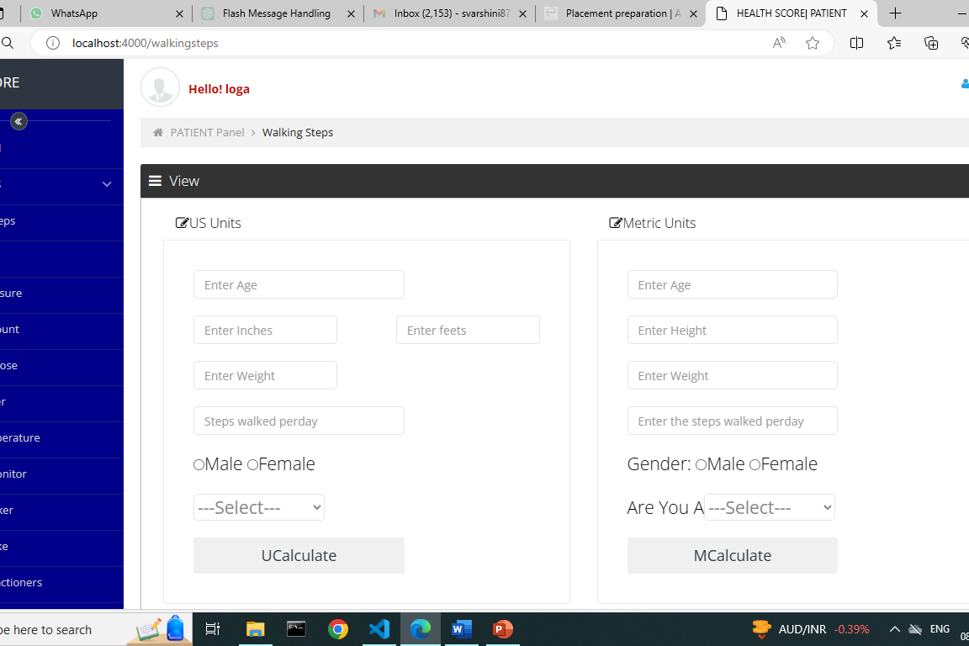
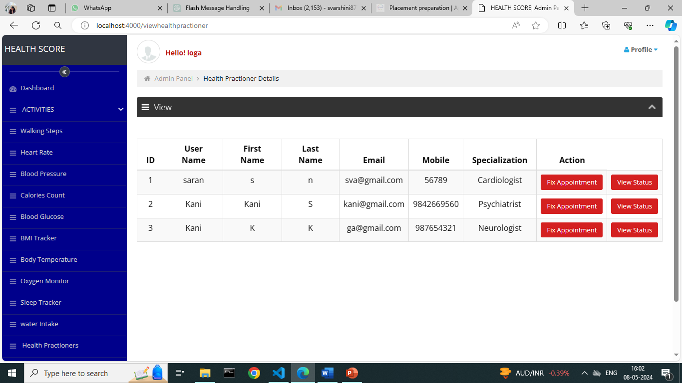
Project Implementation (Picture)

Slide 13
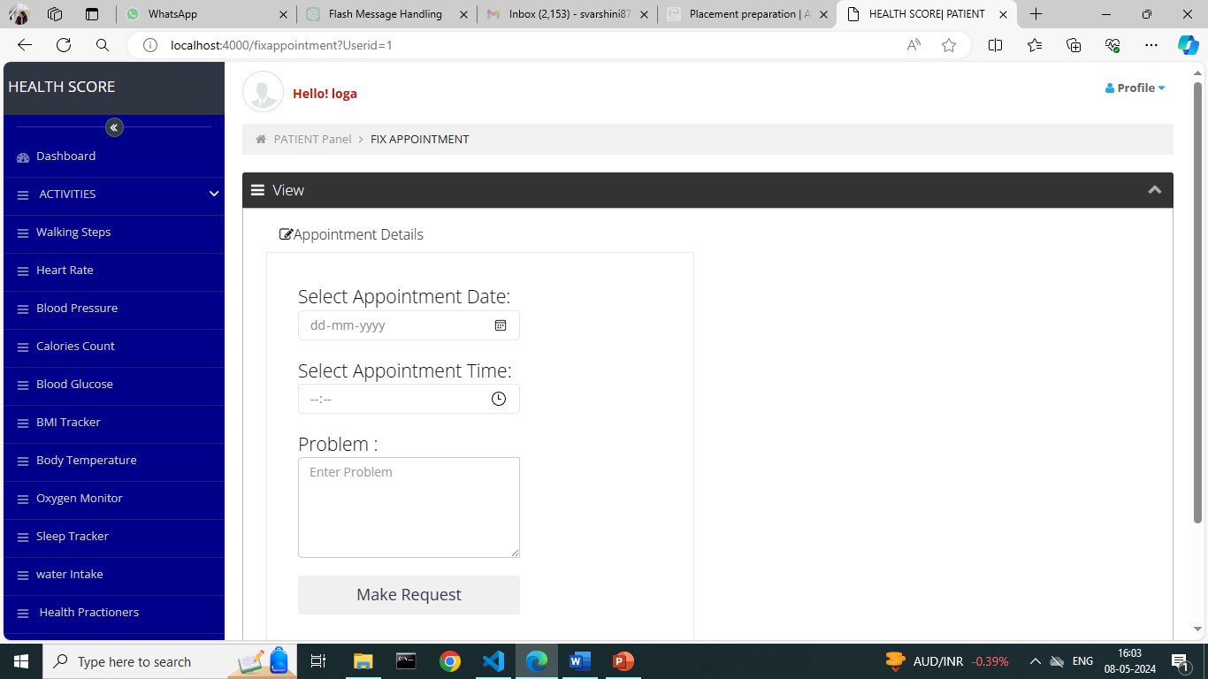
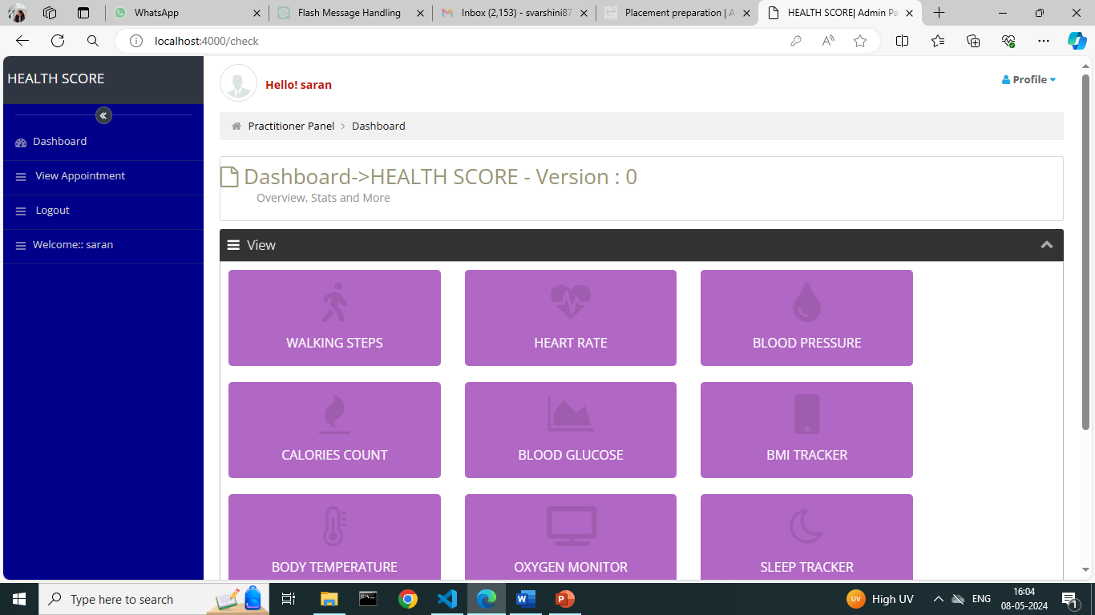
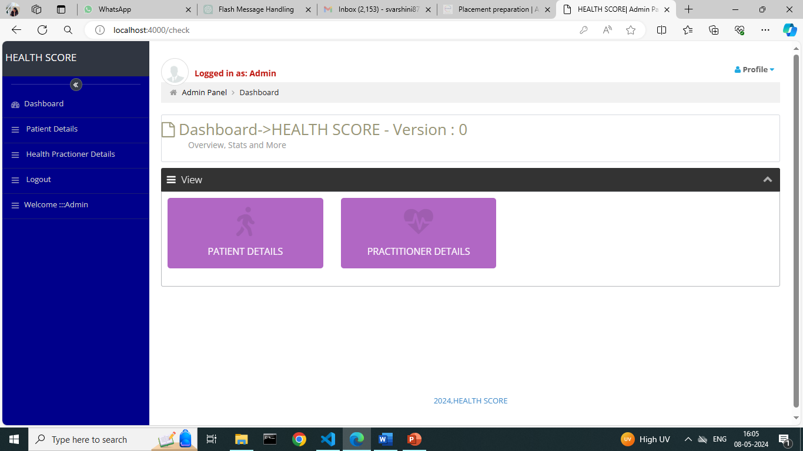
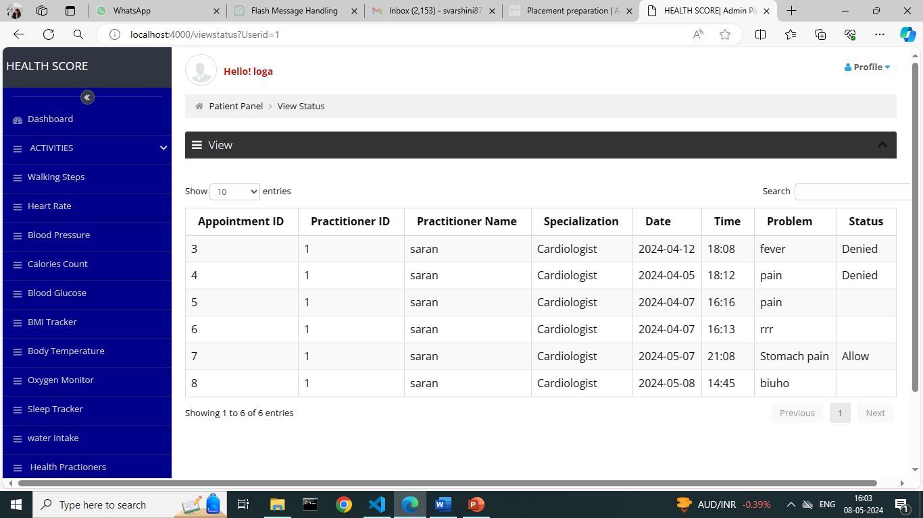

Slide 14
Project Report (Google Drive Link)
https://drive.google.com/file/d/1ApHZpuygC16rK-Tn9VXMf5jGg3tf059J/view?usp=drive_link

Slide 15
Conference Publication
https://drive.google.com/file/d/1shGSvWUCK6jDi5KPrY57dgAuWYTFG5rW/view?usp=drive_link

Slide 16
Final Review Comments
S.No | Comments Received | Response / Corrective Action
1 | Added a one intermediator module between doctor and patient module | The module has been developed
2 | Problem statement is not cleared | Clear to mentioned
3 | Improve Health Care | Implemented
4

Slide 17
Project Completion Status & Plan
Phase | Activity | Project Completion (in %)
First Review | Collected the data set and created the database. | 20%
Second Review | Created a Login page ,Practitioner signup and Patient signup page and other pages. | 40%
Third Review | Front end connected to Back end database using MySQL. | 80%
Model Viva Voce | Completed | 100%

Slide 18
Thank You

